Slide 1
Using Sparklines with Other Graphs
Data Visualization
John F. Tripp

Slide 2
Using Sparklines With Other Graphs
Sparklines have several limitations.
  No axes.
  No detail data.
  Only shape (not level) can be compared between sparklines.
For this reason, we will often use sparklines with other graphs.

Slide 3
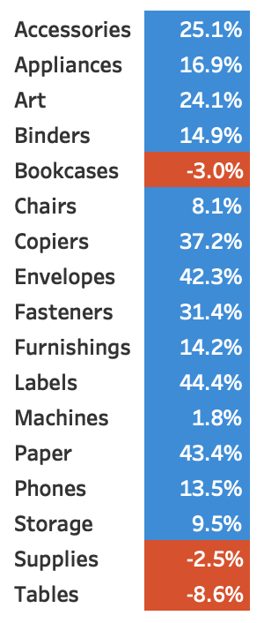
Sparklines with Table

Slide 4
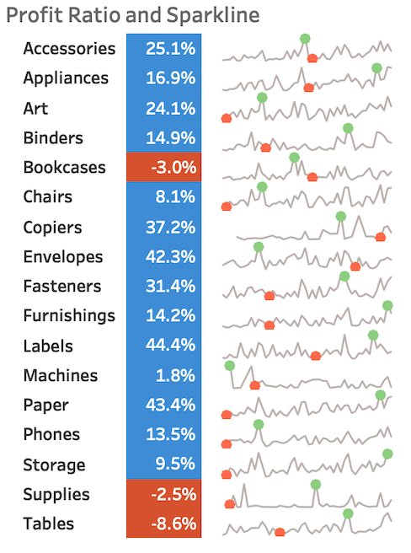
Sparklines with Table

Slide 5
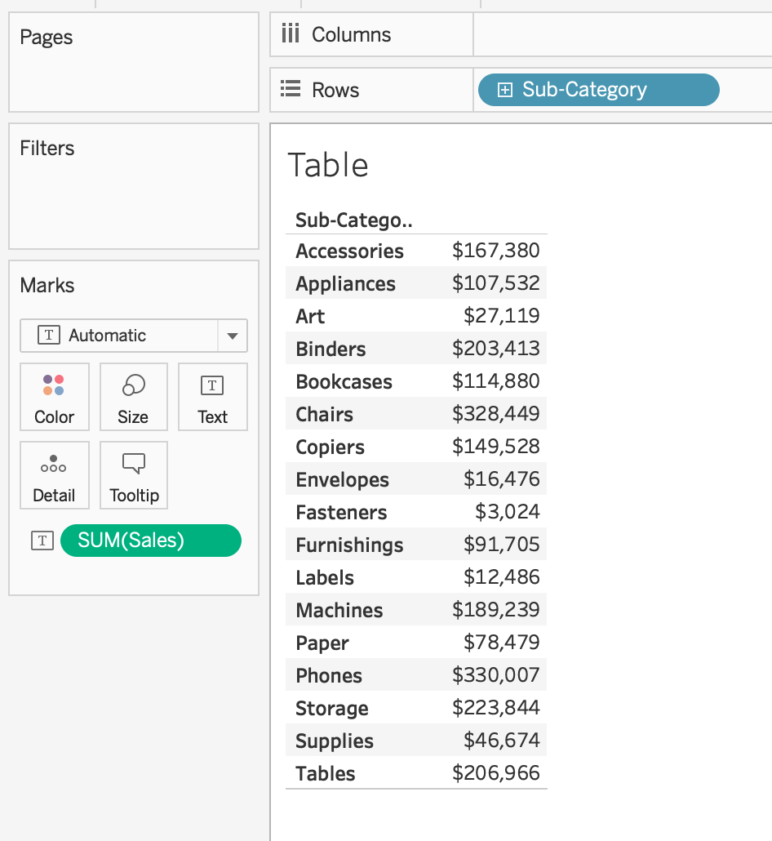
Part One – Data Table
Open the Sparklines with Other Graphs – Start.twbx file.
Create a new sheet called “Table”
Add sub-category to Rows
Add SUM(Sales) to the Text Mark Card

Slide 6
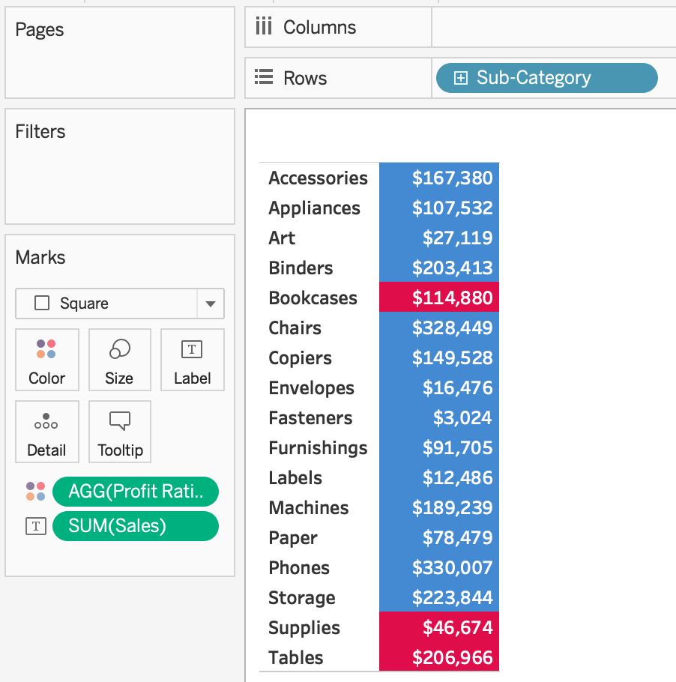
Part One – Data Table
Add Profit Ratio to the color mark card
Change the mark type to square
Modify the color with a two-step red-blue diverging color scheme
Make the label bold (format in the label mark)
Right click the Sub-category heading and choose “Hide Field Labels for Rows”
Delete the title (do not hide it, just delete all text from it)

Slide 7
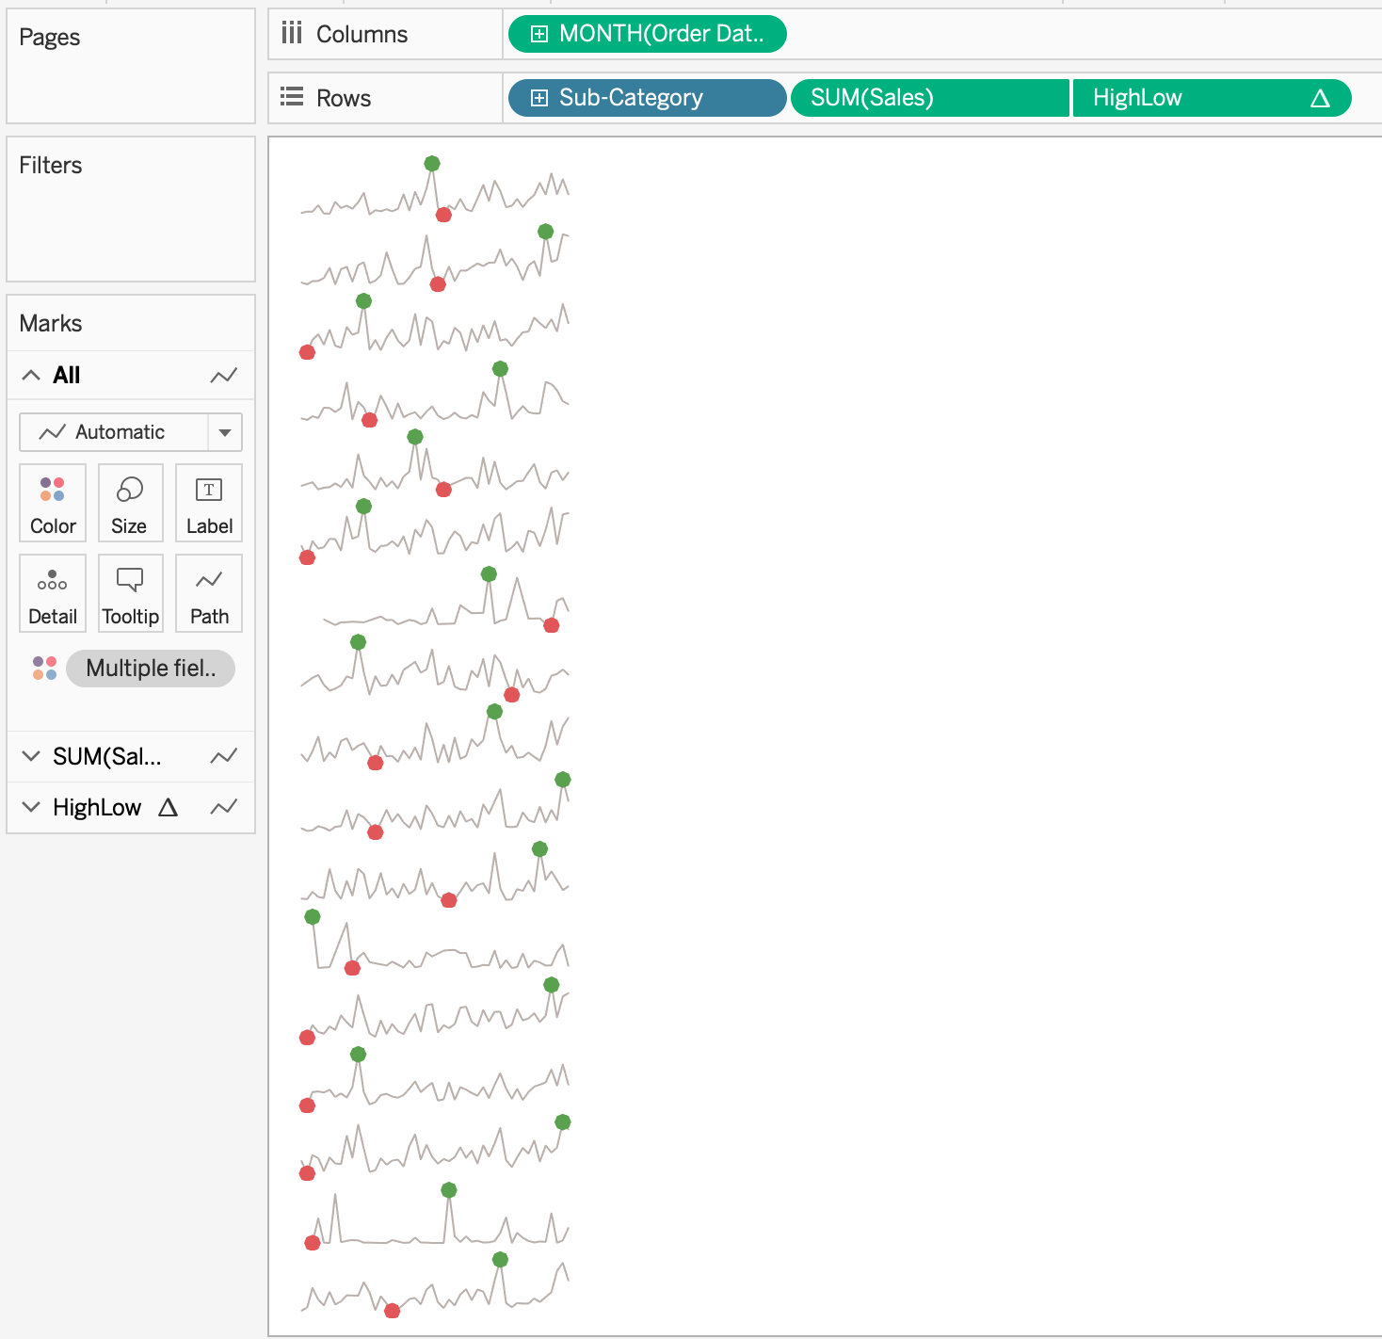
Part Two – Sparklines
Duplicate the Basic Sparklines Graph
Name it “Table Sparklines”
Replace Category with Sub-Category
Hide the Sub-Category Header
Fit Height

Slide 8
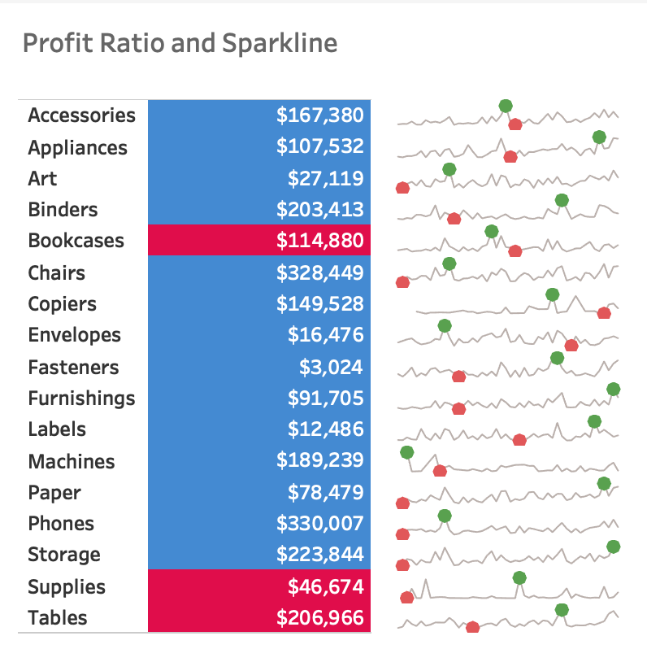
Part Three – Dashboard
Add new dashboard, call it “Table Dashboard”
Resize to 400 x 400
Add Table and Table Sparklines
Size both to about half the area
Fit both to Entire View
Remove Table Sparklines Title Text (do not hide)
Add text area to top, and add text and fit as shown

Slide 9
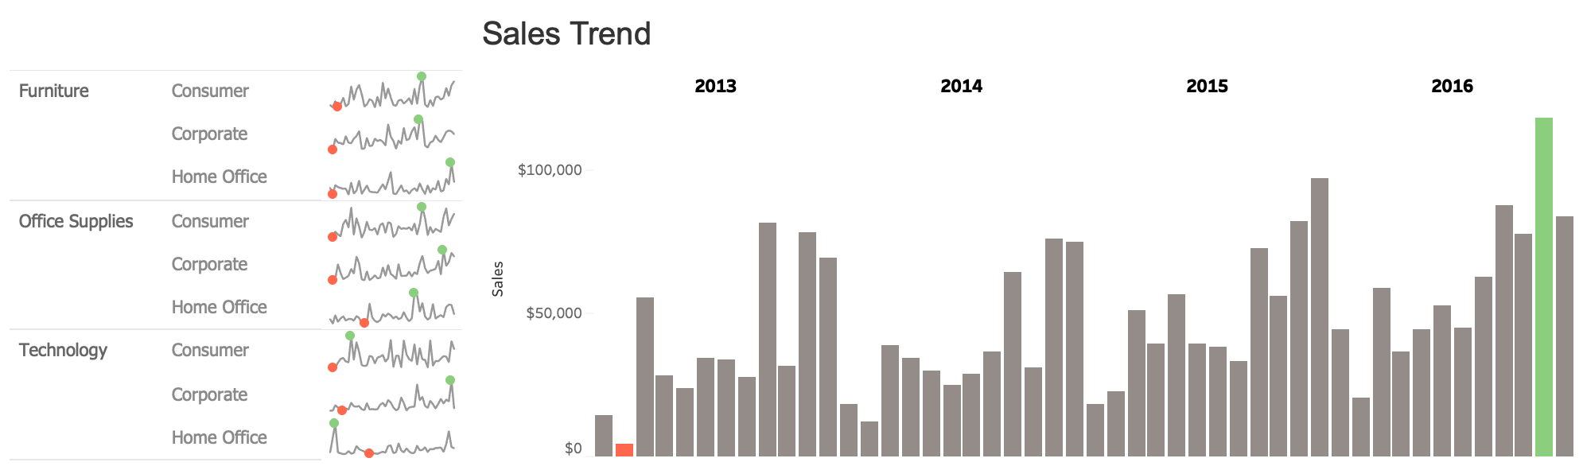
Sparklines with other Graphs

Slide 10
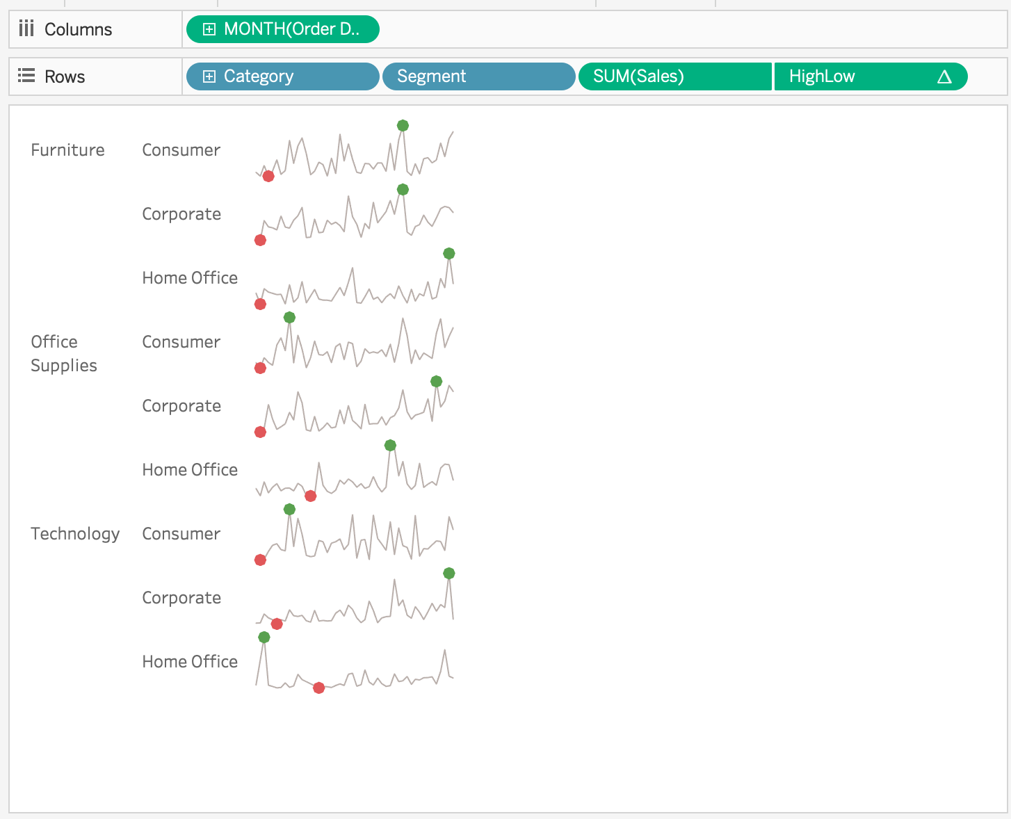
Hands On – Sparklines with Trend
Duplicate the Basic Sparklines Graph
Call the graph Sparklines Detail
Add Segment to the rows shelf

Slide 11
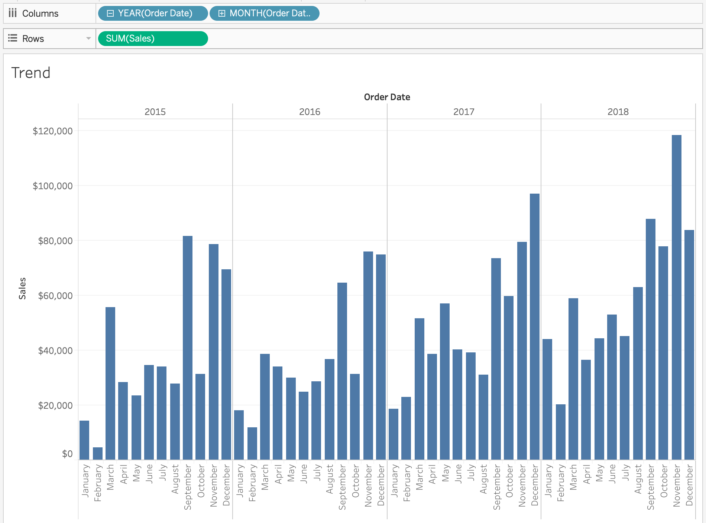
Create the Trend Chart
Create a new sheet – call it Trend
Drag Year(Order Date) to Columns
Drag Month(Order Date) to Columns
Drag Sum(Sales) to Rows
Fit Entire View

Slide 12
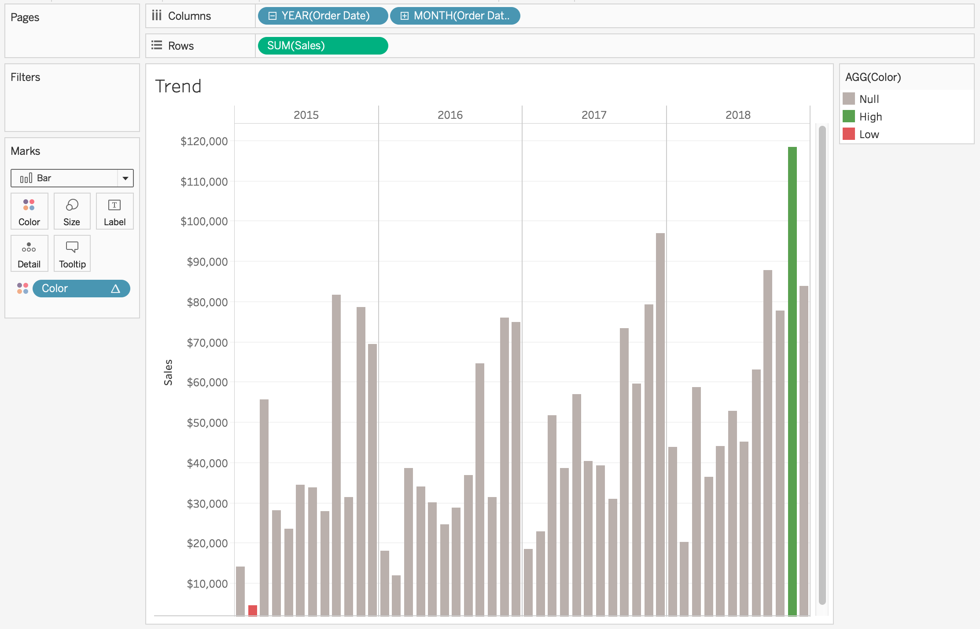
Create the Trend Chart - Formatting
Hide Month(Order Date) Header
Right click on the Order Date header and choose “Hide Field Labels for Columns”
Drop the Color field on Color

Slide 13
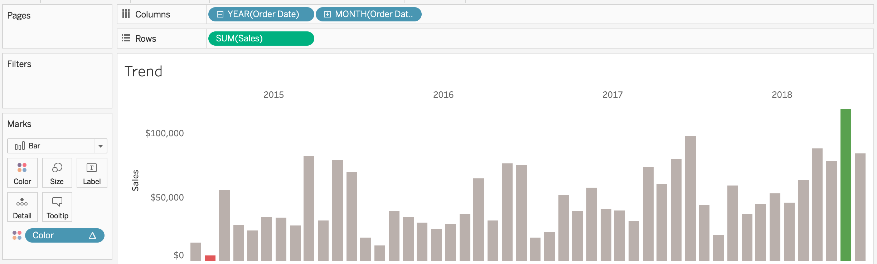
Create the Trend Chart – More Formatting
Hide the Agg(Color) card
Change fit to “Fit Width”
Drag bottom of graph up so it takes ½ the screen
Remove grid lines (Format Pane)

Slide 14
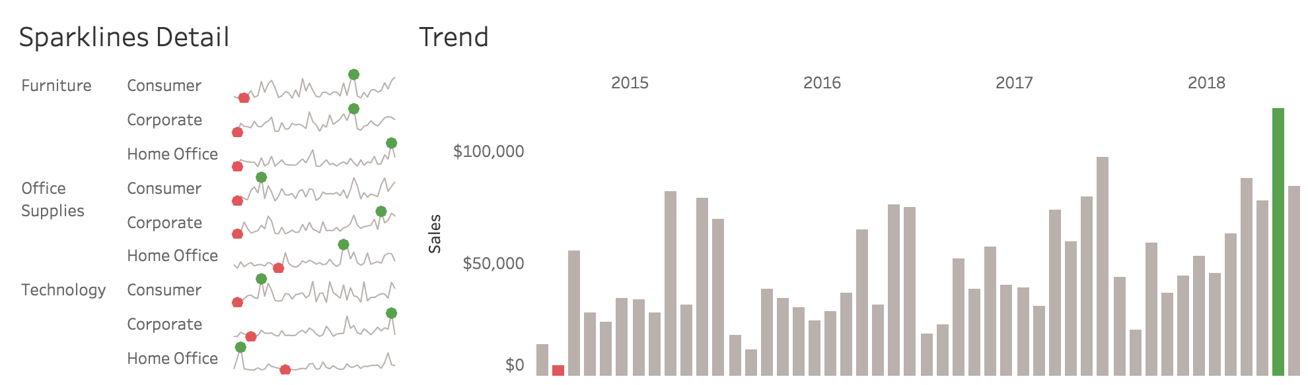
Create the Dashboard
Create a new Dashboard
Size the Dashboard to 1000 x 300
Drag the Sparklines Detail and Trend to the dashboard
Size as shown

Slide 15
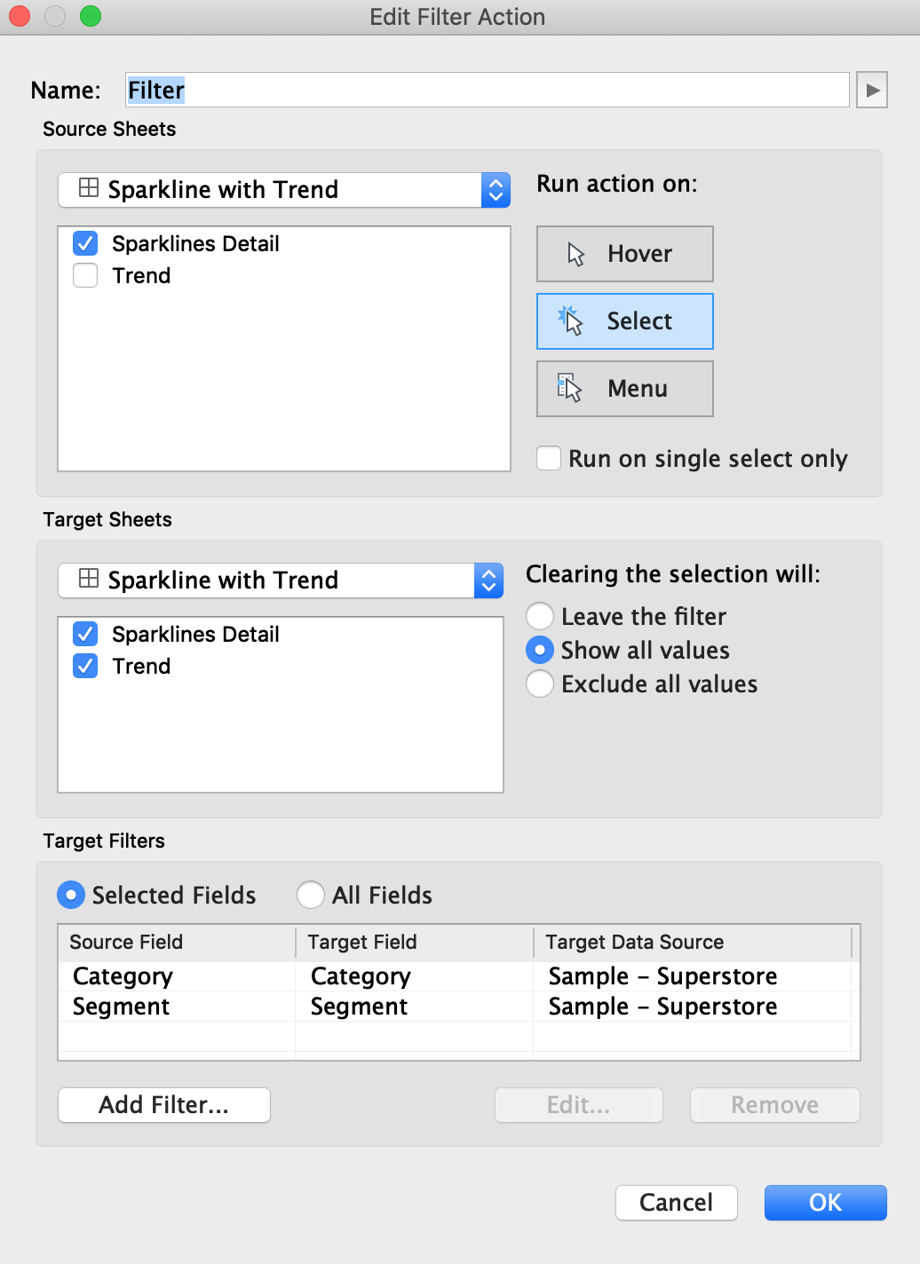
Hands On - Sparklines
Add a filter dashboard action that triggers from Sparklines Detail as shown

Slide 16
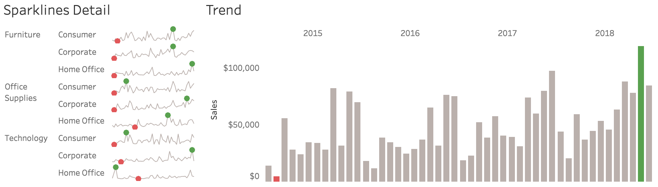
Finished

Slide 17
